Slide 1


Let’s Simplify Business

Slide 2
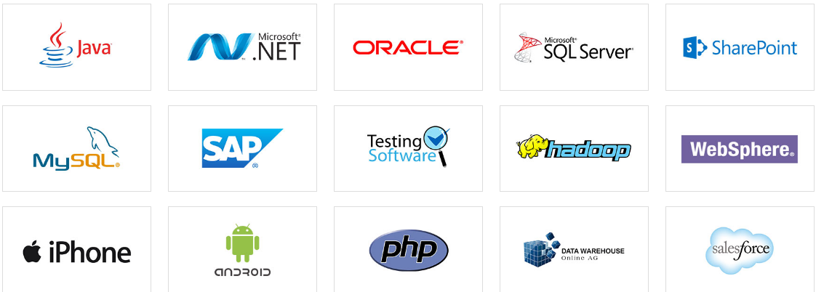
About Us:-
Interface11 is a Global IT Consulting Company, that has been providing high value-added business solutions to enterprises of all sizes.Interface11 has proven competencies in business and technology areas.
At Interface11 we believe in one bare fact i.e. we make relationships, not clients. Whether it may be a Business Giant or a SME, it is dealt with utmost care and ultimate satisfaction which exceeds client’s expectation.
Services:-
Online/Digital Marketing
Offline Marketing
Business Solutions
Commercial Websites
Application Development
Media Advertisement
Technologies we Expertise on

Slide 3
Let’s Simplify Business
Our Products
Business Solutions
These are a few commonly made systems by us-:
ERP
LMS
WFM
CRM
Billing Software
Inventory Management Software
Organizational Management
Our Mantra:- Better, Faster and Cheaper
We ease our partners complicated business procedures by creating systems/software that suits their unique requirements.
We provide personalized solutions to all our clients and we make sure to provide the best at the lowest cost.
“Because we believe every unique business needs an unique solutions.”
Please Click on the links below for a demo of our products -
www.hcc.interface11.com www.stock.interface11.com
www.shapeupfitness.co.in

Slide 4


Our Products-
Business applications
E-commerce applications
Social applications
Educational applications
Please click on the below links to get a few glimpses of our excellence.
https://play.google.com/store/apps/details?id=com.gennxt.olympiadprep
https://play.google.com/store/apps/details?id=com.mindscripts.mindscriptsapp
https://play.google.com/store/apps/details?id=com.shrenoid.apps.besocialz
Application Development
En-power your phone

Slide 5
Commercial Websites
We Provide services other People Love!!!!
We excel in building commercial websites right from general to E-commerce websites including Portfolio and Designing websites at the best possible cost.
“So that getting your business an online platform doesn’t bother your pocket.”
You can click on the below links for checking a few of our active client websites
http://shrenoid.com/
https://shapeupfitness-warje.business.site/
http://www.speakmantra.com/
https://www.mindscripts.com/

Slide 6
Digital Marketing
Strategies focused on increasing the reach and visibility of your Business
We provide the services that are listed below. “So that our clients maintains a constant hold over their positions on google.”
Social Media Marketing
Facebook
Instagram
Twitter
Quora and word press
You Tube
SEO
SEM
SMO

Slide 7
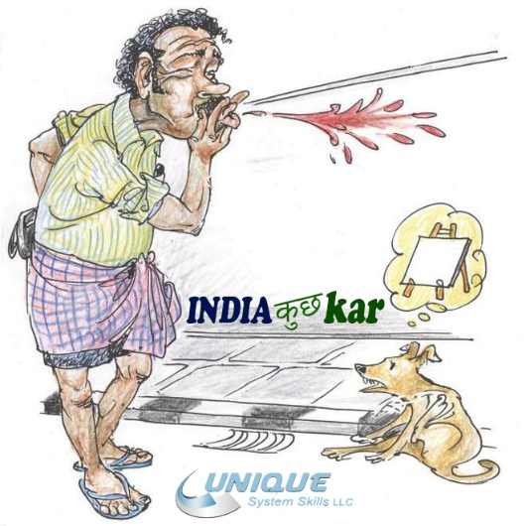
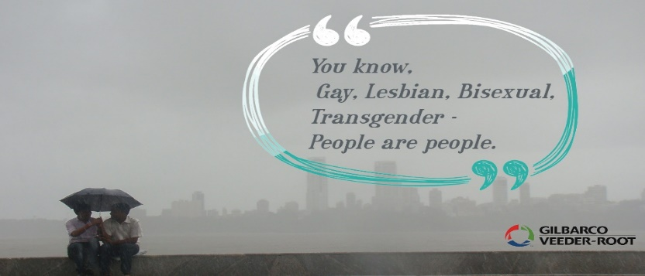
Sample posts for some of our Valued Clients
Topics Covered here are sensitive as we believe in serious business. Its never meant to make every one happy.

Slide 8
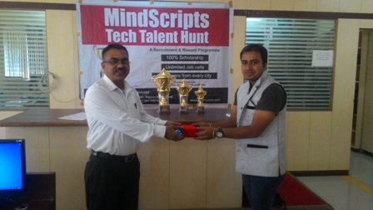
Offline Marketing
We assure you highest market penetration every time.
Our Offline Services-:
ATL- “Value for Money”.
BTL- “We proudly claim to have only the best people at work”
Guerrilla Marketing- “We believe money is not the only solution to everything”.
Events Management-“We love to create experiences that would give the best Memories”
Franchise Building- “So that growing bigger doesn’t weaken your roots”
Vendor Management- “Believe us we have it all”.

Slide 9









Large image

Slide 10
THANK YOU

